Slide 1


Data Mining and Business Analytics Project
Singapore Covid-19 Vaccine Tweets
Sentiment Analysis
by G2T6
Andreas Tan Jia Jun, Lee Kahhe, Tessa Goh Jia Ling, Wang Xian Yang Jerrel, Wesley Ong Yu Kai
Notes:
Good evening Prof and fellow classmates,
Today my group and I would be presenting on our DM project:
A sentiment analysis on COVID-19 vaccines, in particular, in Singapore.

Slide 2

Introduction & Problem Statement
Singapore
Covid-19 Vaccine Tweets Sentiment Analysis
Problem Statement
How does the public view the vaccine?
Do we have sufficient data to make informed decisions?
Which model will perform better when we conduct sentiment analysis?
Notes:
We are fortunate to have a low number of cases in Singapore. However, it does not mean we should be complacent.
Singapore is one of the few countries that has full access to the vaccine, unlike countries like the US.
That being said, are Singaporeans willing to take the vaccine?
There are 3 main motivations behind our project
1. We want to know how the Singapore society views the vaccine,
2. and if we have sufficient information to make an informed decision.
3. We want to know which ML model will perform better when we conduct a sentiment analysis.
Now, let me run you through our literature review, to cover
1. what has been done
2. what we will be doing

Slide 3

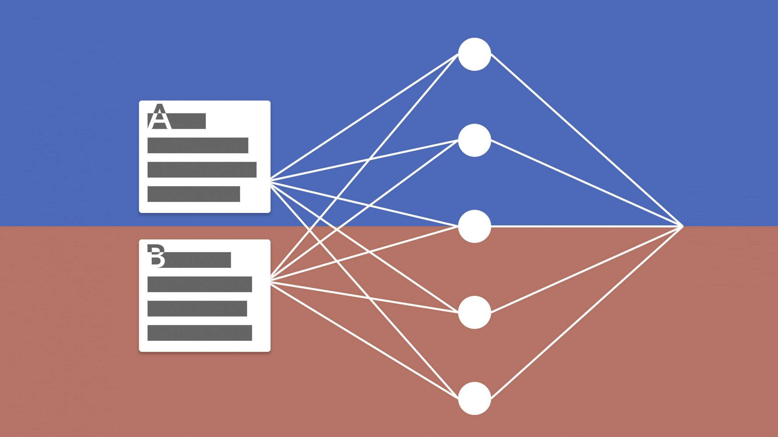
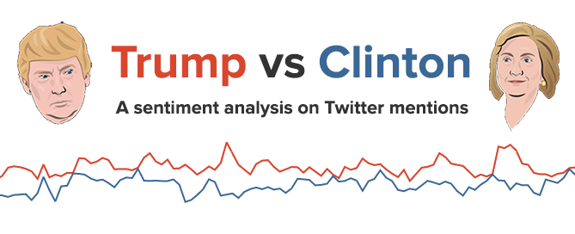
Literature Review | what has been done
Past Use Cases
Limitations of TSA
On the Bright Side
Sentiment Analysis is known to be a popular way to categorise opinions.
Citing a use case back in 2010, sentiment analysis was used to identify shifts in public opinion regarding presidential candidates (Wang et al , 2010)
Using Twitter as a source of data analysis remain poor with reported classification accuracies <70% (Hassan et al, 2013)
Despite the limitations, there are some ways to mitigate these effects and that would be through the method and techniques used for the modelling. A hybrid text document classification approach is said to be able to help increase the accuracies of the model. (Usman, 2019)
Notes:
Firstly, we found that sentiment analysis is seen to be a popular way to categorise opinion.
Citing a use case back in 2010, it is seen that sentiment analysis was used to identify public opinion regarding presidential elections.
Many turn to twitter as a source of data for sentiment analysis, as it is a platform that has data mainly in text format.
However, it is said that using twitter as a source of data analysis remains poor, reporting classification accuracies of <70%
On the bright side, despite these limitations, there are some ways to mitigate these effects. For example, using a HYBRID TEXT DOCUMENT CLASSIFICATION approach is said to be able to help increase the accuracies of the model.
-----------------------------------------------------------------------------------

Slide 4

Literature Review | what needs to be done
Formulate a classification model to accurately predict the sentiment towards Covid19 vaccines
Input Variables: Web-scrapped tweets
Output Variables: Predicted sentiment of Singaporean's outlook on Covid19 vaccine
Notes:
Armed with all this information,
My team & I are looking to FORMULATE a CLASSIFICATION MODEL to accurately predict the sentiment towards Covid19 vaccines
· We are using web-scrapped tweets as our input variables
· And looking to predict Singapore’s sentiment on the covid19 vaccine as our output variable.

Slide 5
Literature Review | what needs to be done
k-NN
Simple SVM
Neural Network
K-NN is known to be inuitive and simple algorithm to understand & implement
However, it suffers from Curse of Dimensionality: KNN works well with small number of input variables but as the numbers of variables grow K-NN algorithm struggles to predict the output of new data point (Genesis, 2018)
Simple SVM is known to be a traditional ML method and is widely used for large-scale sentiment analysis because they scale well.
SVM is effective in high diemnsional spaces, unlike k-NN
However, it will not perform well if the dataset has a lot of noise (i.e., target classes overlapping) (Dhiraj, 2019)
It is said that Deep Learning (DL) methods achieve better accuracy as compared to SVM. However, they are thought to be typically slower and more expensive to train & operate. (Jose, 2019)
Notes:
1. K-NN is known to be n intuitive and simple algorithm to understand & implement
However, it suffers from Curse of Dimensionality: KNN works well with small number of input variables but as the numbers of variables grow K-NN algorithm struggles to predict the output of new data point. You would see that this becomes one of our challenges later on. https://www.fromthegenesis.com/pros-and-cons-of-k-nearest-neighbors/
2. Using Support Vector Machine (SVM) is said to
However, its downfall
https://dhirajkumarblog.medium.com/top-4-advantages-and-disadvantages-of-support-vector-machine-or-svm-a3c06a2b107
3. https://underthehood.meltwater.com/blog/2019/08/22/deep-learning-models-for-sentiment-analysis/

Slide 6




Tools
Python v3.7.4 running on Jupyter Notebook
X
Pandas, NumPy, Scikit-Learn, Matplotlib, Seaborn

Slide 7

Datasets
This dataset is for training our models
Model Evaluation Phase
Data Mining
Random Forest
KNN
Various SVM
Neural Network
SpaCy
Gensim
Training Data
Generic Dataset*
162,414
General Tweets (Labelled)
Select the Best Performing Model
Twint Dataset
4,733
Singapore Tweets (Unlabelled)
Test Data
This is our main data set
Twint Dataset
4,733
Singapore Tweets (Unlabelled)
“Test” Set
900
Manually Labelled
Lexicon Model
TextBlob
Vader
IBM
Notes:
Here is an overview of our datamining journey, we aacquired a generic dataset from kaggle which was labelled in order to train our models, then the trained models would then be fitted with our test set, this test set data was

Slide 8
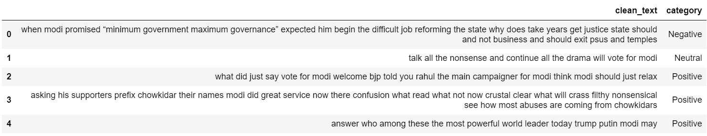
Dataset 1 | Sample Generic Dataset (After Cleaning)
Purpose
Description
Cleaning
Training the models
From Kaggle
Generic tweets with labeled sentiment
Positive | Negative | Neutral
Data Preprocessing
Stemming
Lemming
Vectorization

Slide 9
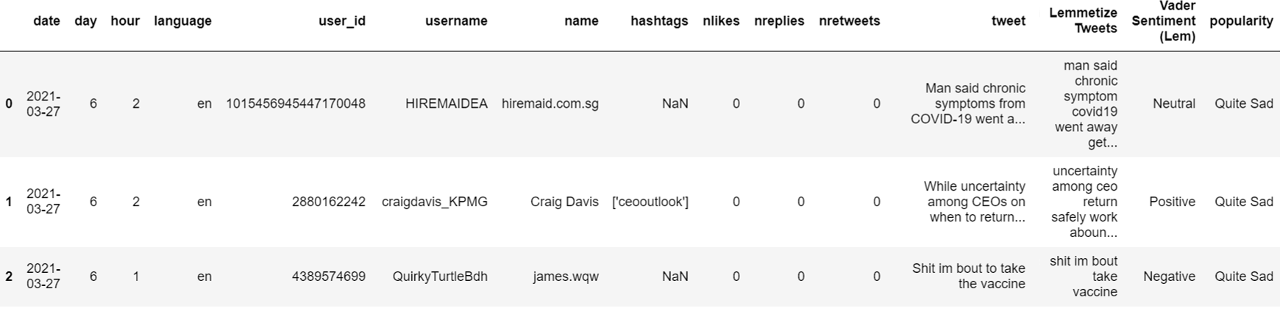
Dataset 2 | Sample Twint Dataset (After Cleaning)
Purpose
Description
Cleaning
Our main data set
Searching for insight
Crawled using Twint project
COVID-19 related tweets with un-labeled sentiment
Data Preprocessing
Stemming
Lemming
Vectorization
Manual labeling of 900 rows for testing

Slide 10



Methodology | Process flow
Training
Testing
Evaluating
First we will be training the models with Dataset1 using the following
Neural Network
Random Forest
KNN
SVM
Linear
Kernal
spaCy
Gensim
The models will then be tested on Dataset2
Models will be evaluated based on train and test accuracy

Slide 11
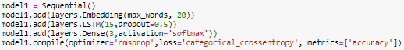
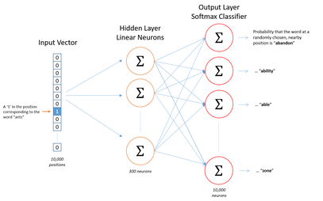
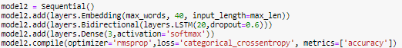
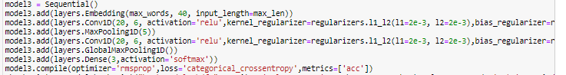
Methodology | Neural Network
What is Neural Network
A subset of machine learning where it can recognize patterns. Neural Networks help us to cluster and classify.
Optimiser: rmsprop
Loss: cat_crossentropy
Activation: softmax
Dropout: 0.5
Model Performance
LSTM Model
Generic: Test Accuracy: 91%
Twint: Test Accuracy: 37.33%
Evaluation: Takes time and sequence into account
Bidirectional LSTM Model
Generic: Test Accuracy: 94%
Twint: Test Accuracy: 38.44%
Evaluation: Able to catch more complex patterns than a single RNN
Conv1D Model
Generic: Test Accuracy: 89%
Twint: Test Accuracy: 23%
Evaluation: Faster model and demands cheaper computational cost
Evaluation
Challenging to train neural network models, requires hyperparameter tuning. Overall, low accuracy on Twint data due to overfitting
Notes:
We tried to implement a recurrent neural network model for sentiment analysis using KERAS
LSTM layers (as well as all other RNN layers) can take several arguments but the ones that we defined are 15 which is the number of hidden units within the layer (dimensionality of the output space) and the dropout rate of the layer we set it to 50%, For our optimizer, we used the rmsprop, loss = categorical crossentropy because we were dealing with a multiclass task and In the LSTM example we stack a Dense layer with three output units that would be the 3 possible classes of our dataset. In order to make probabilistic outputs, we used the ‘softmax’ as activation function in the final layer.
optimizer is, it’s simply the mechanism that constantly computes the gradient of the loss and defines how to move against the loss function in order to find its global minima and therefore, find the best network’s parameters (the model kernel and its bias’ weights)
Dropout is one of the most effective and most commonly used regularization techniques for NNs and consists of randomly turning off hidden units during training, that way the network does not rely 100% on all its neurons and instead, forces itself to find more meaningful patterns in the data in order to increase the metric you’re trying to optimize.
How the bidirectional layer works is that it maximizes the order sensitivity of the RNNs: essentially it consists of two RNNs (LSTMs or GRUs) that process the input sequence in one different direction to finally merge representations. By doing this, they’re able to catch more complex patterns than a single RNN layer would catch. In other words, one of the layers interprets the sequences in chronological order and the second one do so in anti-chronological order, that’s why Bidirectional RNNs are widely used, because they offer greater performance than regular RNNs.
1D Convolutional neural networks
this is one of the fastest models out there when talking about convergence — it demands a cheaper computational cost.

Slide 12
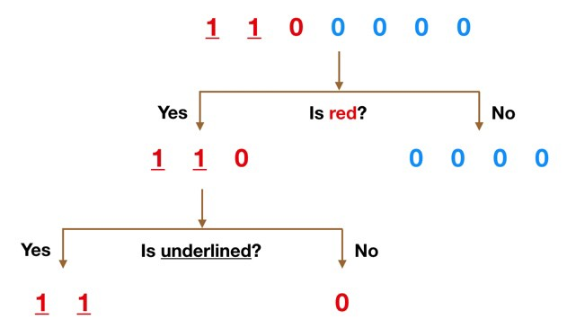
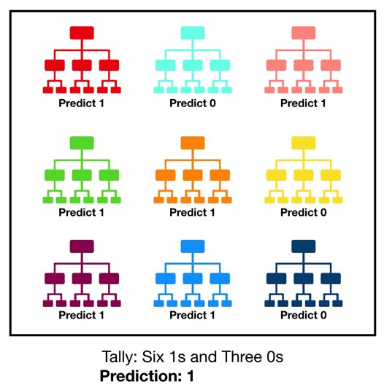
Methodology | Random Forest
What is Random Forest
Consists of many individual decision trees that operate as an ensemble. Each individual tree in the random forest spits out a class prediction and the class with the most votes becomes our model’s prediction
Model Performance
Generic: Test Accuracy: 75.53%
Twint: Test Accuracy: 53.67%

Slide 13
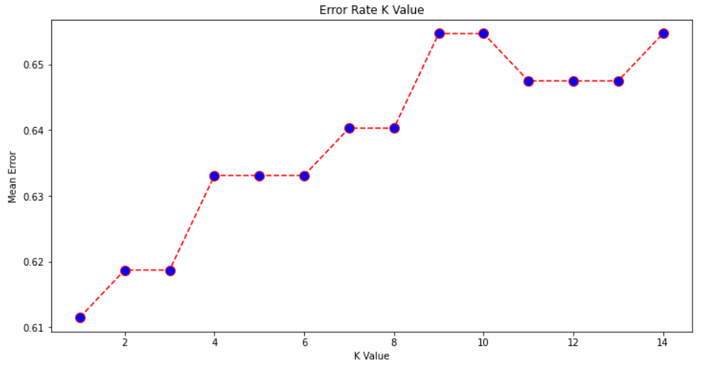
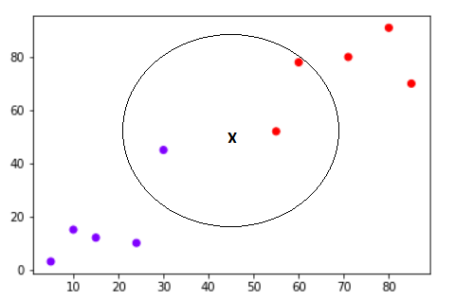
Methodology | KNN
What is KNN
Calculates the distance of a new data point to all other training data points. It then selects the K-nearest data points, where K can be any integer. Finally, it assigns the data point to the class to which the majority of the K data points belong.
Finding ideal value of K
Model Performance
Generic: Test Accuracy: 38.88%
Twint: Test Accuracy: 34.00%
Evaluation: KNN model is too simple
Doesn't work well with high dimensional data because with large number of dimensions, it becomes difficult for the algorithm to calculate distance in each dimension.
Does not work well with categorical features since it is difficult to find the distance between dimensions with categorical features

Slide 14
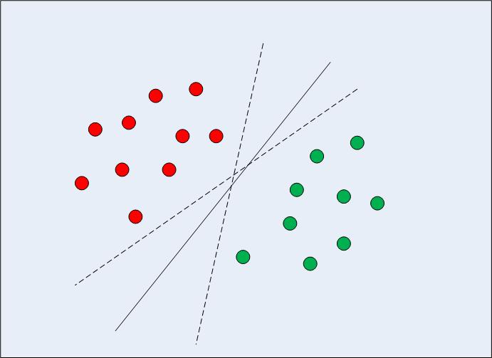
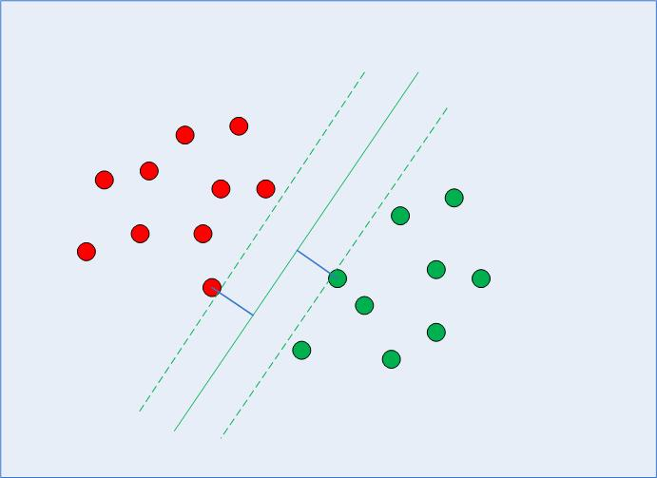
Methodology | Simple SVM
What is Simple SVM
Find a boundary that divides the data in such a way that the misclassification error can be minimized. If you closely look at Fig. 1, there can be several boundaries that correctly divide the data points. The two dashed lines as well as one solid line classify the data correctly.
Model Performance
Generic: Test Accuracy: 79.13%
Twint: Test Accuracy: 54.44%
Evaluation: Out-performed the random forest

Slide 15
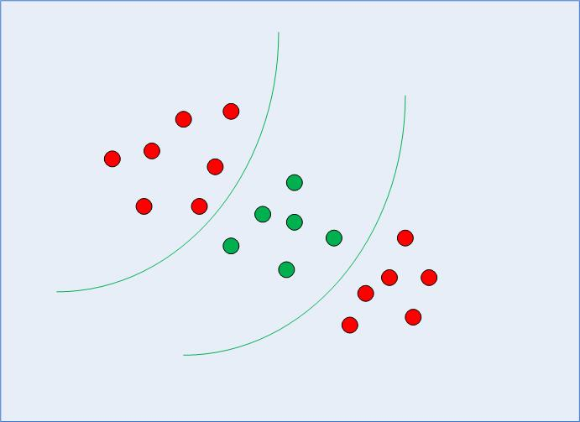
Methodology | Kernel SVM
What is Kernel SVM
Finds decision boundary with a curved line instead of a straight line
Simple
Kernel
Model Performance
Polynomial
Generic: Test Accuracy: 49.80%
Twint: Test Accuracy: 33.33%
Evaluation: Returns 0&1 which is more suited for binary classification
Guassian
Generic: Test Accuracy: 78.41%
Twint: Test Accuracy: 53.67%
Sigmoid
Generic: Test Accuracy: 76.97%
Twint: Test Accuracy: 54.56%
Evaluation
Sigmoid Kernel SVM performed the best. There is no hard and fast rule for which Kernel SVM is the best, must test all to see which is the best.

Slide 16
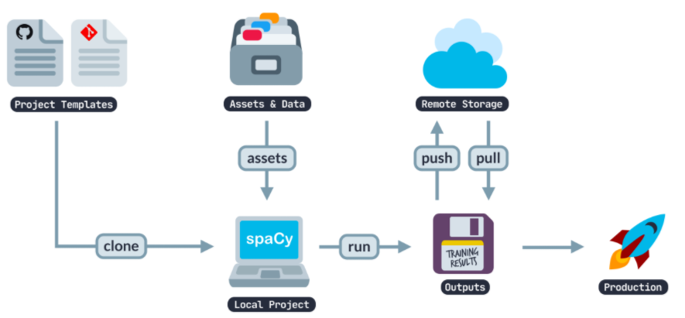
Methodology | spaCy
What is spaCy
SpaCy provides a one-stop deep-learning framework which comes with prebuilt models for tasks in NLP projects such as Tokenization, Lemmatization, POS tagging, Entity Recognition, Dependency parsing and many others. Under the hood it has its own NLP deep learning library called thinc
spaCy's pipeline, allows us to speed up all the processing tasks.
Model Performance
Generic: Test Accuracy: 51.18% Twint: Test Accuracy: 53.66%
Challenges: It can be relatively hard to fine-tune the model if it does not match spaCy's prebuilt model → Less flexibility
Notes:
Make use of spaCy pipeline and invoke nlp to do all the pre-processing task due to the prebuilt models.
As we are using a 3 - class classification, having an accuracy of 50% and above is consider good.
Reason: We built our data based on spaCy prebuilt model, so they have already done all the tokenization, lemmatization, etc. For example, you can’t build a classifier that takes both text, numerical, and image data at the same time to produce a classification.

Slide 17
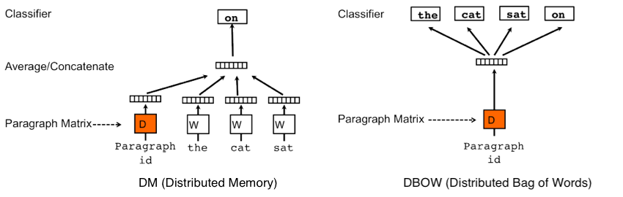
Methodology | Gensim
What is Gensim
A python library originally developed for topic modelling but now mainly for NLP tasks. It converts words & documents to vectors, which in this case we will be using the Doc2Vec model.
Methods used:
DBOW(Distributed bag of words)
DMC (Distributed Memory Concatentated)
DMM (Distributed Memory Mean)
Model Performance
Generic: Test Accuracy: 61.77%
Twint: Test Accuracy: 41.33%
Challenges: Limited features as it does not operate on a complete NLP toolkit like NLTK/spaCy
Notes:
The test accuracy might need to work hand-in-hand with other ML methodology such as NLTK/spaCy to get a more accurate result.
Gensim -> doc2vec
DM and DBOW
DM: Vectors are obtained by training NN on the task of inferring a center word based on context words and a context paragraph
DBOW: Vectors are obtained by training NN on the task of predicting a probability distribution of words in a paragraph given a randomly sampled word from the paragraph
But all in all our model basically just different ways of obtaining the vectors for each text, then train them using Logistic Regression

Slide 18
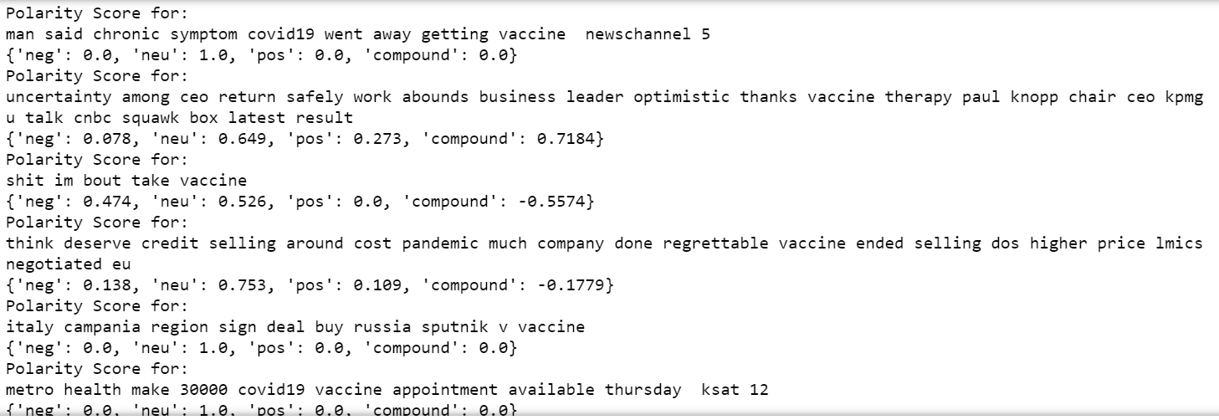
Methodology | Lexicon
TextBlob | Vader | IBM
Analyse inputs and return a tuple {polarity & subjectivity) and uses the polarity to determine whether is it positive or negative. Results: Test Accuracy: 64.1 % | Analyse inputs and return a dictionary of polarity scores {Positive, Neutral, Negative} and uses the compound score (normalized score) to determine polarity. Results: Test Accuracy: 68.6% | Analyse inputs and return response score between -1 and 1 to determine polarity. Results: Test Accuracy: 68.6%
Metrics used to determine polarity score: Positive = > 0.1 Negative = < -0.1 Neutral = > -0.1 and < 0.1 To provide a more accurate analysis based on polarity score, we have catered the scoring to -0.1 for negative and 0.1 for positive as we believed that if the polarity score is 0.01, it is almost negligible and should be consider as neutral instead of positive.
Summary: Although the various lexicon models all has high accuracies, we decided to go ahead with VADER for our analysis as it has the highest accuracy and is able to analyse based on compound score which is a good representation.
Notes:
VADER’s sentiment analyzer class will return the polarity score in dictionary format which will help in evaluating the probability of a positive, negative or neutral sentiment. Compound score is computed by sum of all lexicon ratings normalized between -1 and 1. Taking a look at this example of a vader analysis of our dataset, you can see that for some for instance the 2nd tweet. The neutral is 64.9% , however accordingly to the compound score, it computes as positive 71.84% instead.

Slide 19
Methodology Summary
Model | Train Accuracy | Test Accuracy | Evaluation
Neural network | 90.00% | 35.00%
Random Forrest | 75.53% | ​53.67%
KNN | 38.88% | 34.00% | Worst
Simple SVM | 79.13%​ | 54.44%
Kernel SVM (Polynomial) | 49.80% | 33.33%
Kernel SVM (Guassian) | 78.41% | 53.67%
Kernel SVM (Sigmoid) | 76.97% | 54.56% | Best Train Model
spaCy | 51.18% | 53.66%
Gensim | 61.77% | 41.33%
TextBlob | - | 64.10%
Vader | - | 68.20% | Best Overall
IBM | - | 68.20%
*Insight: Lexicon based method performed better than learning based method
Notes:
Take note in mind that our models are using a 3-class classification, henceforth getting 50% accuracy is considered quite good alr as quoted by prof.

Slide 20
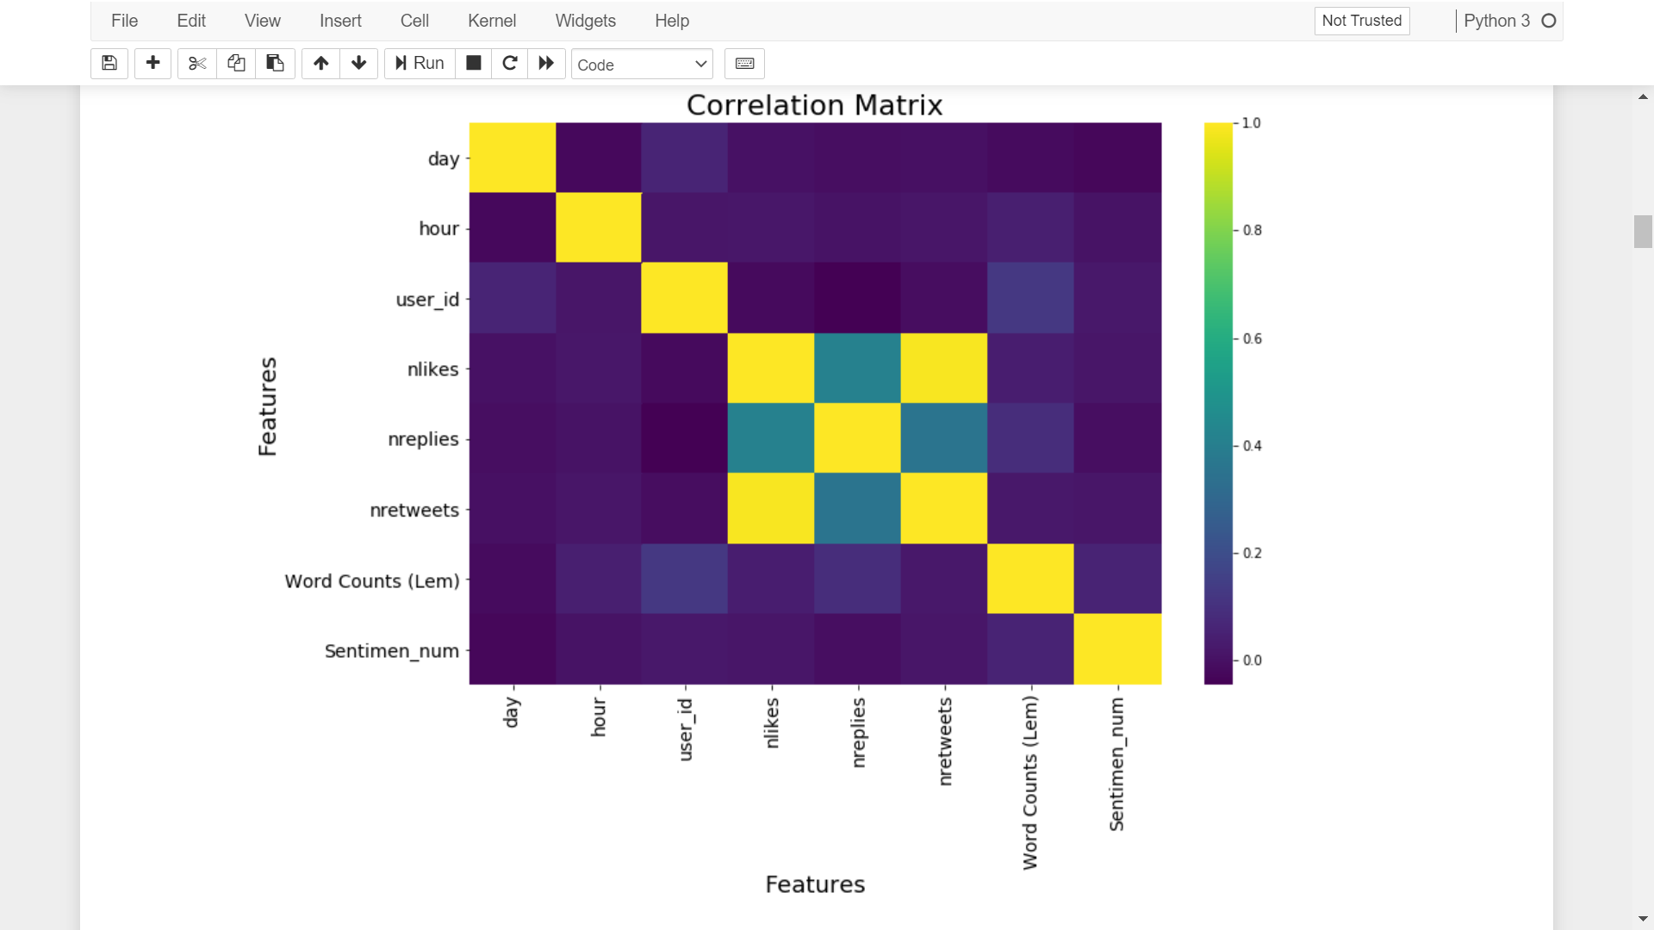
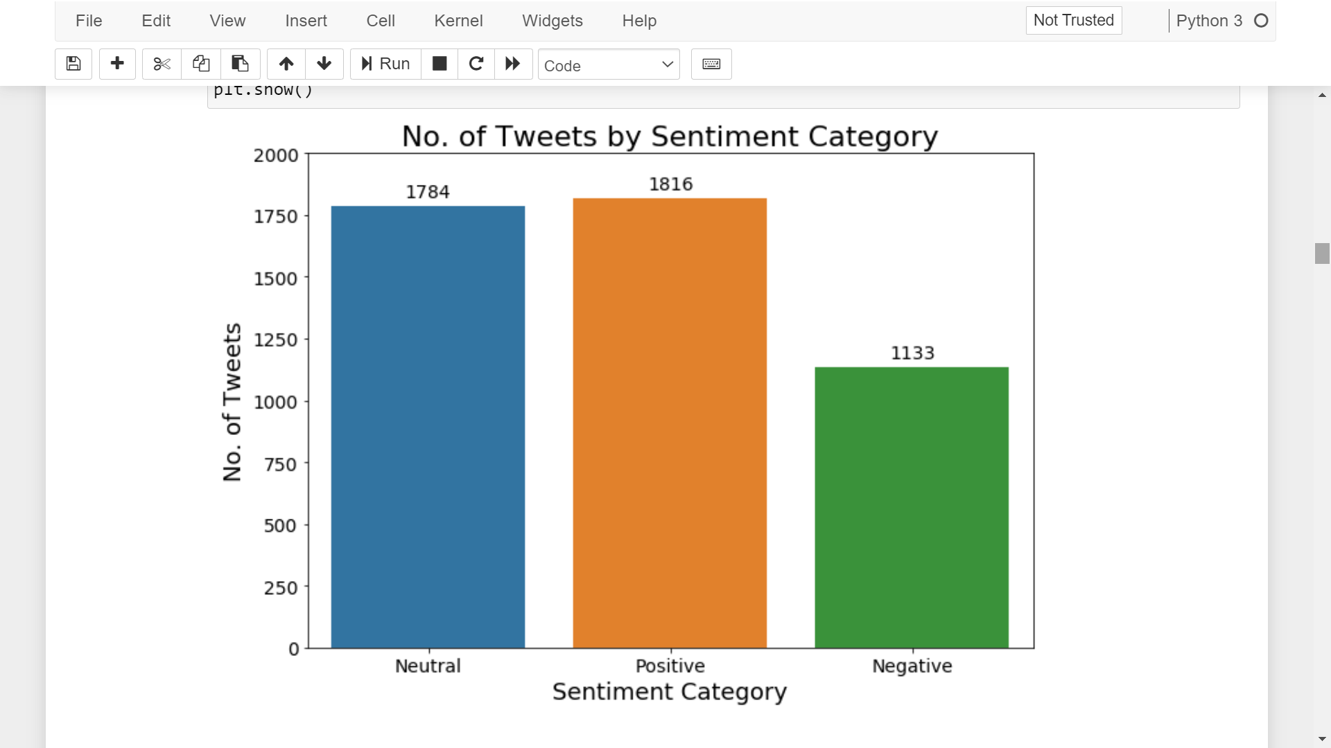
Data Analysis | General Overview
Notes:
Nothing much interesting here.
Only that the Negative level is much lower, which brings the question as to why then the low local adoption.

Slide 21
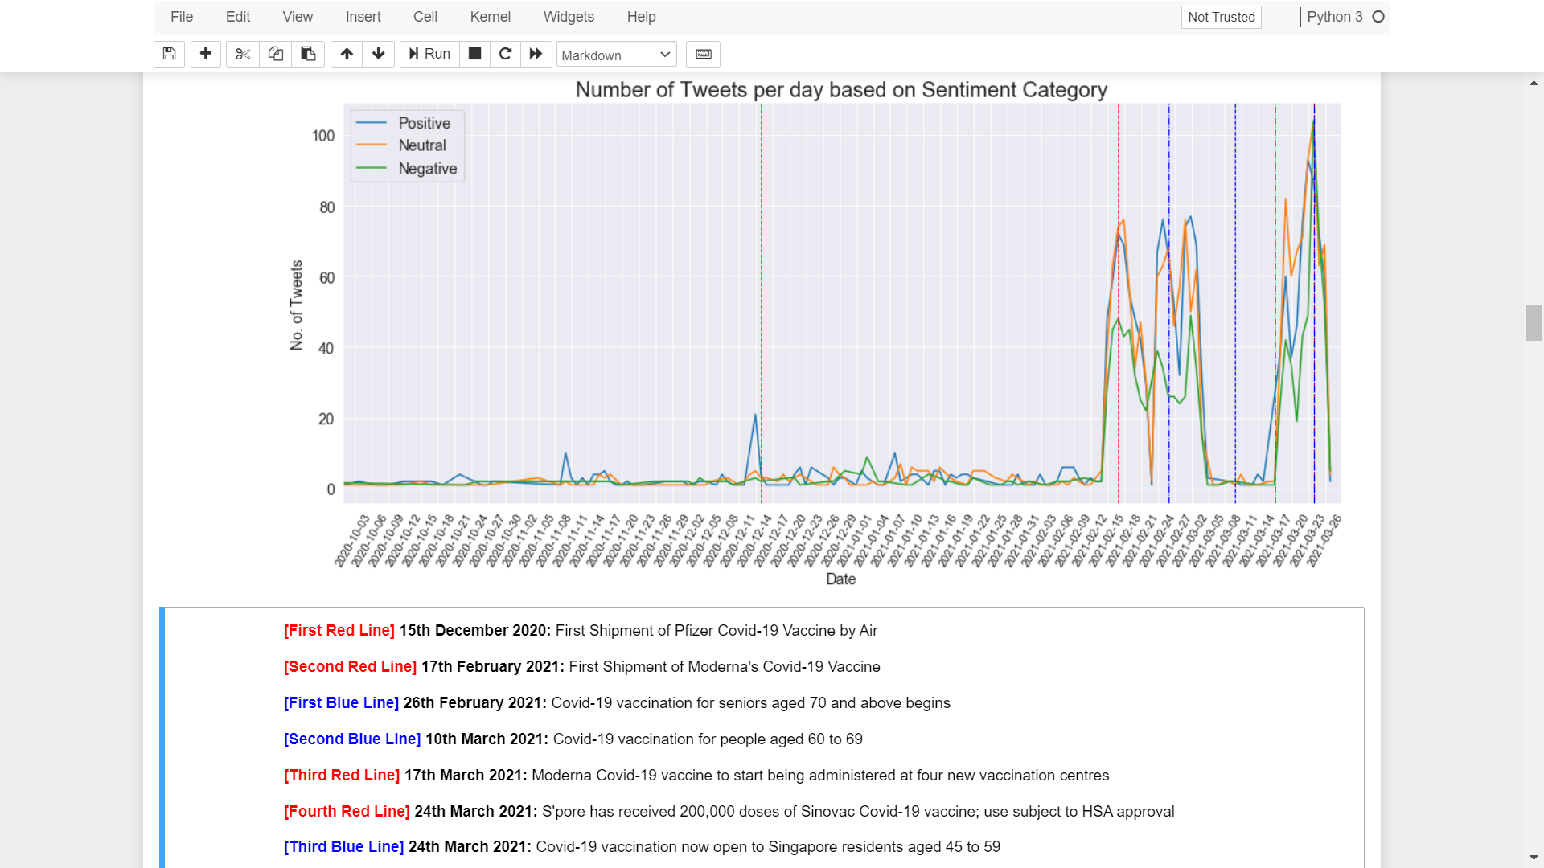
Local Tweets Sentiment Trend
Generally, most of the tweets are either Neutral or Positive
Only till recently we then see a fair share of all sentiment category
Big Question: Why is there still a lack of interest* in Singapore on covid-19 vaccination?
*General Sensing based on those around us
Notes:
Big Question -> Which I will come back to this point after we look at other aspects.

Slide 22
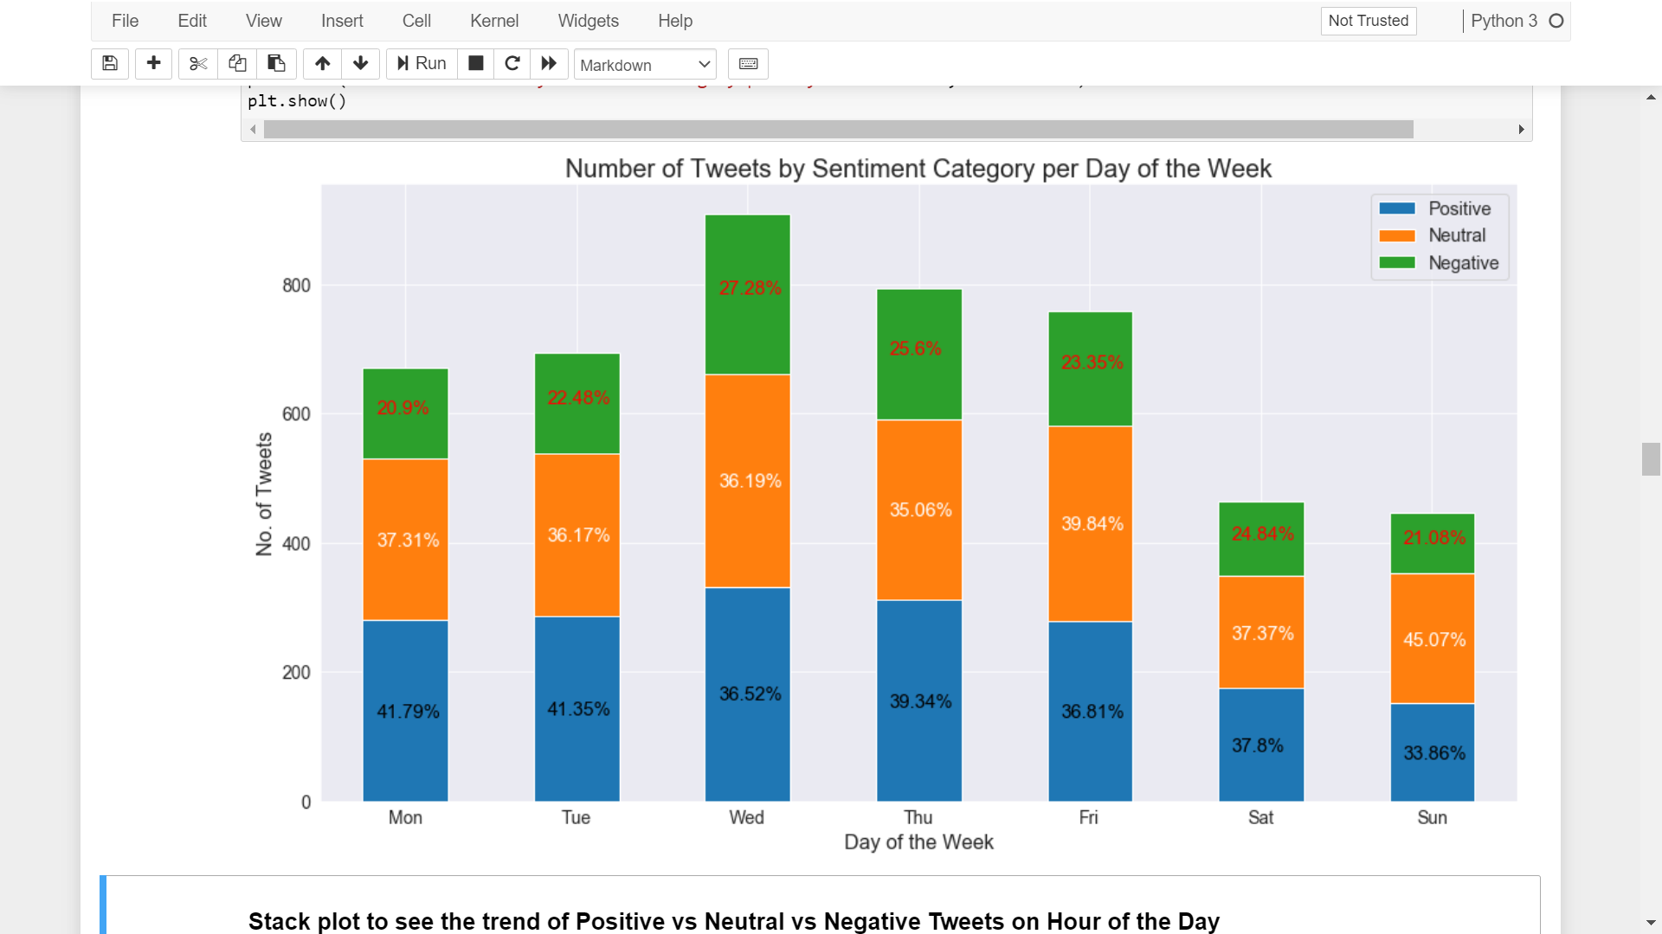


Sentiment Spread per Day of the Week
People tweet more during weekdays, especially mid-week
Most Positive Day is Monday
Most Negative Day is Wednesday
Government can thus strategically plan encouraging vaccine adoption advertisement during mid-week where most tweets are generated (greater reach) with higher negative percentage.
Notes:
Now that you have a better understanding of the different sentiment trends, we then dive deeper into analysing the sentiment spread per day of the week.
So that it can help us in proposing alternative considerations that the government can take to improve local vaccine adoption.
Let’s look at the positive day and negative day, for positive day, we can see that it is Monday, at high 41.79%, almost on par is also Tuesday …..
Given this information, in order to target on increasing local covid adoption, we can propose that government to strategically schedule advertisement during such timing to target on higher negative population.
So now we know which day to target. we want to then know which hour would then be a good timing.

Slide 23
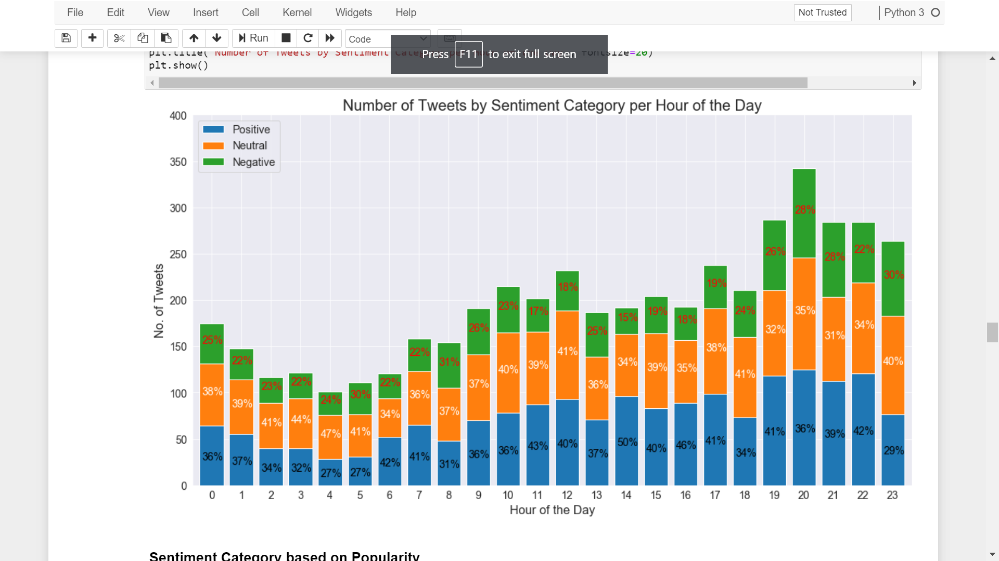
Sentiment Spread per Hour of the Day
People tweet more during night time, especially 8pm+-
Positive Timing is around afternoon
Negative Timing is around early morning and night time
Government can thus strategically plan encouraging vaccine adoption advertisement during negative timing, especially night time where most tweets are generated for greater reach
Notes:
As expected, people usually tweets more during night time, around 8pm +-
And not sure why, there are still a good number of people tweeting during such ungodly hour.
Again lets look at the positive and negative. So for positive …..
So similarly, to reach out to as many negative people, we can then proposed advertisement during either early morning or late night
So now we know when to which day and what time to target, lets look at who to target!

Slide 24
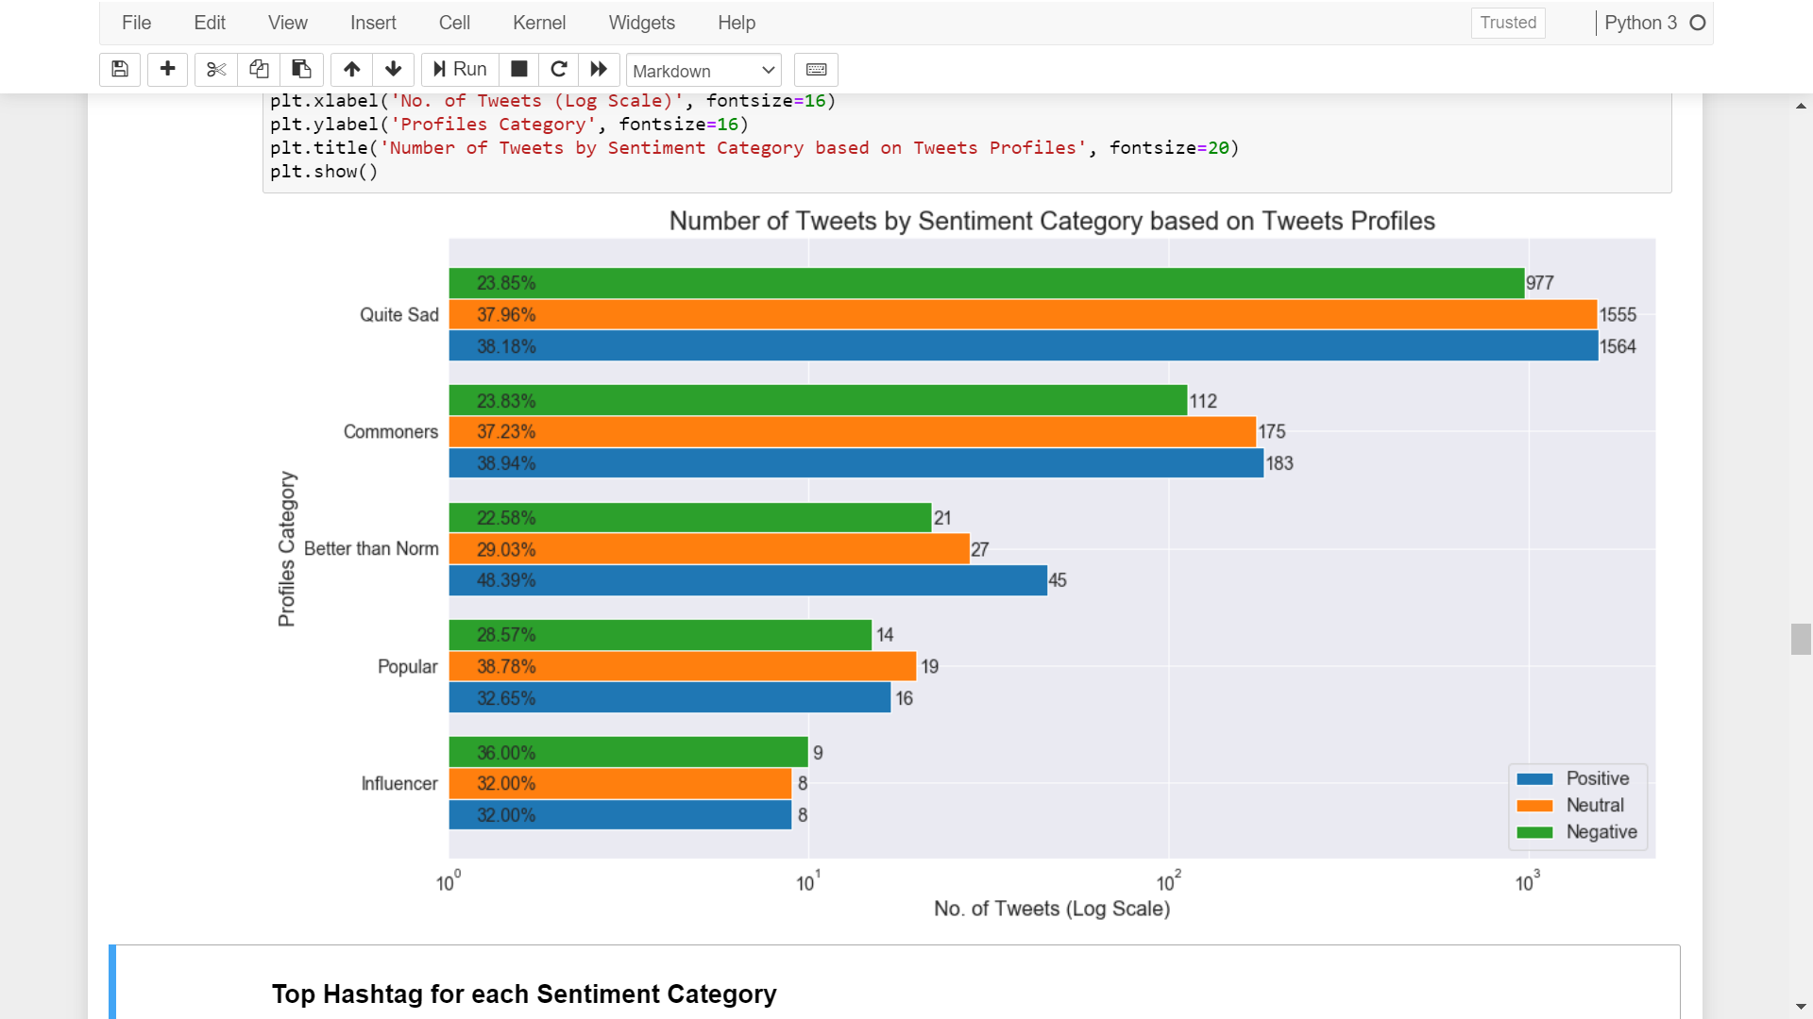
Sentiment Spread by Profiles
Positive Group:
Better than Norm -> Commoners -> Quite Sad
Negative Group:
Influencer -> Popular
Although majority of the public views are in the positive side, government can consider engaging higher social influence level people to spread awareness given that they have a higher percentage negative tweets which could be an underlying reasons as to low local adoptions! Social media is powerful! (W-O-M)
nLikes > x
nRetweets > x
nReplies > x
Influencer: x = 100
Popular: x = 50
Better than Norm: x = 20
Commoners: x = 5
Quite Sad: The rest
Notes:
As promised previously during proposal phase, I have thus utilize the no of likes/ retweets and replies into a column called profiles
The determining of which class the tweet belong to is based on this logic as shown here.
So positive and negative group as shown here…

Slide 25
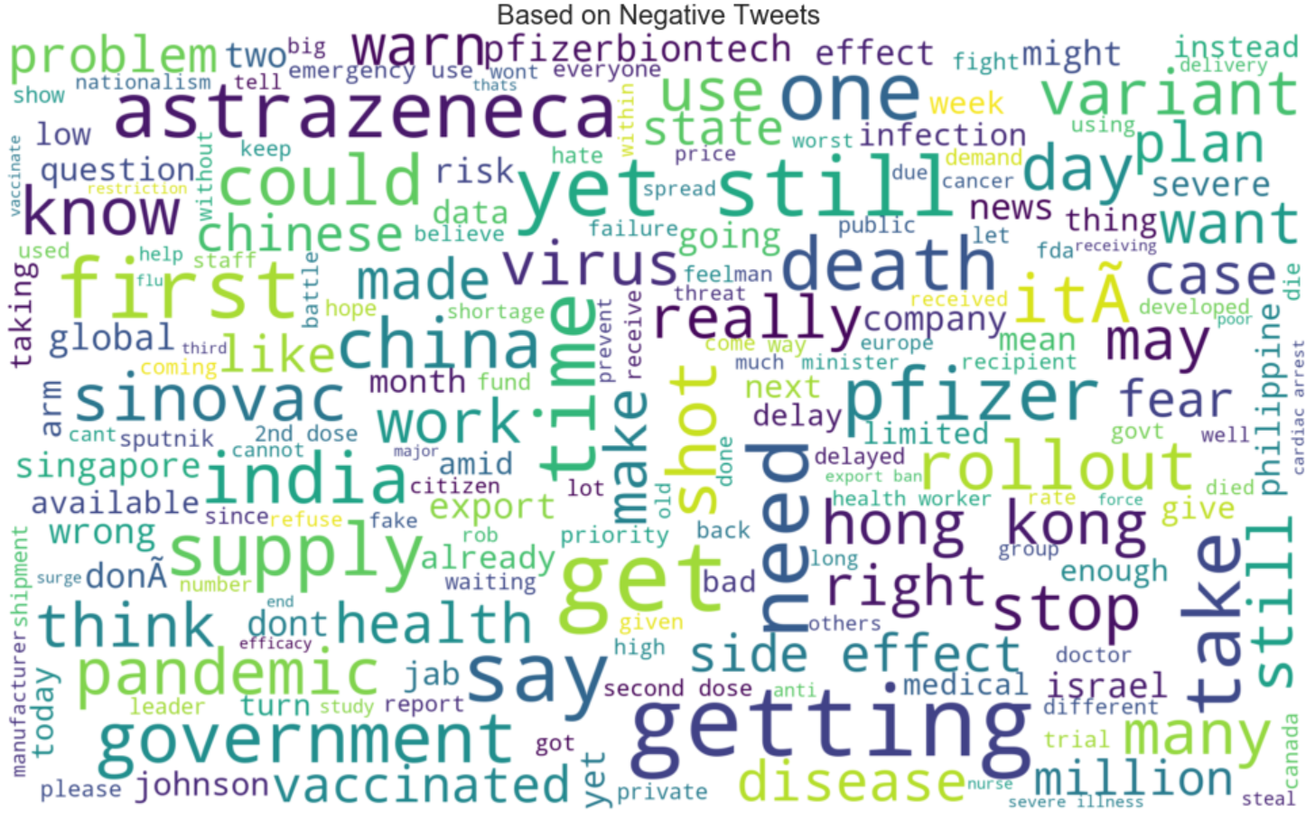
WordCloud | Negative Tweets
Problem
Warn
Risk
Question
Failure
Effect | Side Effect
Fear
Die | Died
Cardiac Arrest
Fake
Severe Illness
Notes:
Maybe if I could take your attention to the words highlighted in red, xxxx
General sensing here seems to surface uncertainty, fear and scared of the risk

Slide 26
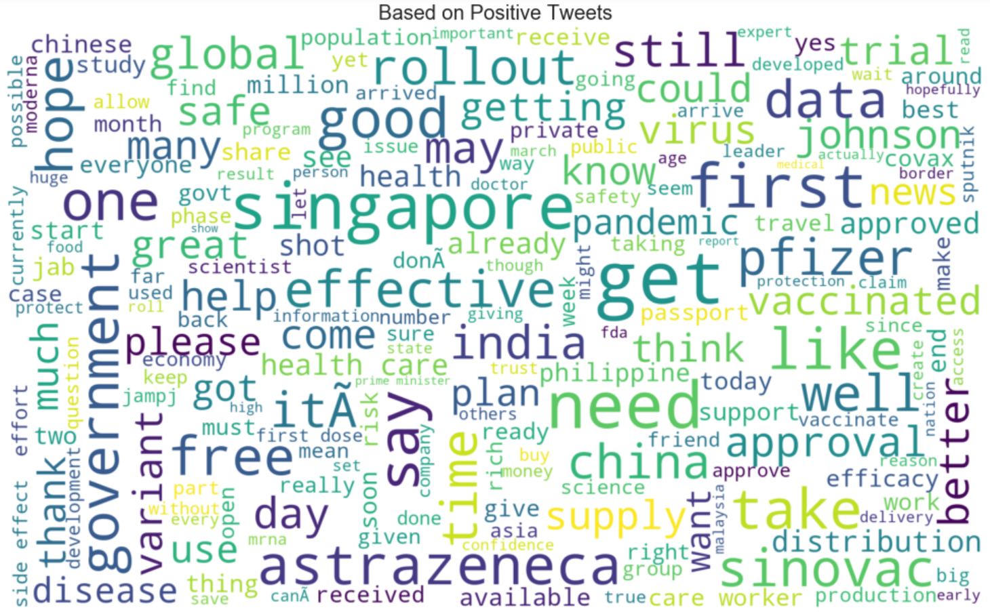
WordCloud | Positive Tweets
Back to the Big Question!
Safe | Safety
Good | Great
Effective
Approved | Approval
Protect | Protection
Confidence
True
Risk
Side Effect
Notes:
Back to the big question, not only we want to find out from negative tweets, but also there might be a possibility where those people that are negative towards covid vaccine could very much lies within the positive tweets

Slide 27



Data Analysis | Findings
Our sentiment analysis shows that the general* impression towards covid-19 vaccine are leaning towards uncertainty, fear, and risky
*Based on People living in Singapore
To help increase local adoption of covid-19 vaccination. We proposed that the government can:
Strategically scheduled encouraging vaccine adoption advertisement during mid-week or either morning or night time
Tapped on high social influence level people to help spread awareness on the knowledge of covid-19 vaccine

Slide 28
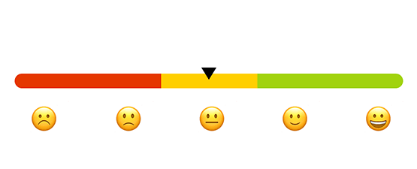
Future Works | Enhancing Lexicon Model
Semantic Orientation CALculator (SO-CAL) – Project lead by Dr. Maite Taboada
Professor, Department of Linguistics, Director, Discourse Processing Lab, Associate Member, School of Computing Science
SO-CAL is applied to the polarity classification task. Uses dictionaries of words annotated with their semantic orientation, along with other techniques [See next slide].
Semantic orientation (SO) is a measure of subjectivity and opinion in text. It usually captures an evaluative factor (positive or negative) and potency or strength (degree)
Notes:
Lexicon-Based Methods for Sentiment Analysis
Professor, Department of Linguistics, Director, Discourse Processing Lab, Associate Member, School of Computing Science
http://cognet.mit.edu/pdfviewer/journal/coli_a_00049
Semantic Orientation CALculator (SO-CAL)
Intensification: a positive adjective has an SO value of 2, an amplified adjective would have an SO value of 3, and a down toned adjective an SO value of 1
If sleazy has an SO value of−3,somewhat sleazy would have an SO value of:−3×(100%−30%)=−2.1. If excellent has a SO value of 5,most excellent would have an SO value of: 5×(100%+100%)=10. Intensifiers are applied recursively starting from the closest to the SO-valued word: If good has an SO value of 3, then really very good has an SO value of (3×[100%+25%])×(100%+15%)=4.3
Negation: simply to reverse the polarity of the lexical item next to a negator, changing good(+3) into not good(−3).
Negation search in SO-CAL includes two options:
Look backwards until a clause boundary marker is reached
Look backwards as long as the words/tags found are in a backward search skip list, with a different list for each part of speech.
Well, at least he’s not sleazy. (−3→1)
Well, it’s not dreadful. (−4→0)
It’s just not acceptable. (1→−3)
It’s not a spectacular film, but ... (5→1)
Text-Level Features: Lexicon-based sentiment classifiers generally show a positive bias (Kennedy andInkpen 2006)
Normalization, shifting the numerical cut-off point between positive and negative reviews
Decreasing the weight of words that appear more often in the text E.g. death, turmoil, and war each appear twice. A single use of any of these words might indicate a comment (e.g.,I was bored to death), but repeated use suggests a descriptive narrative
Improving the performance of lexicon-based review sentiment analysis method by reducing additional introduced sentiment bias
https://journals.plos.org/plosone/article?id=10.1371/journal.pone.0202523
Enhancing Pre-trained Language Model with Lexical Simplification:
https://arxiv.org/abs/2012.15070

Slide 29
Future Works | Enhancing Lexicon Model
Semantic Orientation CALculator (SO-CAL) – Project lead by Dr. Maite Taboada
Professor, Department of Linguistics, Director, Discourse Processing Lab, Associate Member, School of Computing Science SO-CAL is applied to the polarity classification task. Uses dictionaries of words annotated with their semantic orientation, along with other techniques.
Semantic orientation (SO) is a measure of subjectivity and opinion in text. It usually captures an evaluative factor (positive or negative) and potency or strength (degree)
Intensification: Using neighboring adjectives to increase/decrease the semantic intensity of the lexical item E.g., somewhat sleazy (SO value of : −3× (100%−30%)
Switch Negation: reverse the polarity of the lexical item next to a negator E.g., Well, at least he’s not sleazy. (−3→1)
Polarity Shifting: polarity expressed by the sum of the content words in the sentence E.g. I am not disappointed
[Article] Fine-grained sentiment analysis of social media with emotion sensing ★★★★★
Employs a social adaptive fuzzy similarity-based classification, with the ability to identify their prevailing emotion categories
[Article] Enhancing Pre-trained Language Model with Lexical Simplification
Notes:
Lexicon-Based Methods for Sentiment Analysis
Professor, Department of Linguistics, Director, Discourse Processing Lab, Associate Member, School of Computing Science
http://cognet.mit.edu/pdfviewer/journal/coli_a_00049
Semantic Orientation CALculator (SO-CAL)
Intensification: a positive adjective has an SO value of 2, an amplified adjective would have an SO value of 3, and a down toned adjective an SO value of 1
If sleazy has an SO value of−3,somewhat sleazy would have an SO value of:−3×(100%−30%)=−2.1. If excellent has a SO value of 5,most excellent would have an SO value of: 5×(100%+100%)=10. Intensifiers are applied recursively starting from the closest to the SO-valued word: If good has an SO value of 3, then really very good has an SO value of (3×[100%+25%])×(100%+15%)=4.3
Negation: simply to reverse the polarity of the lexical item next to a negator, changing good(+3) into not good(−3).
Negation search in SO-CAL includes two options:
Look backwards until a clause boundary marker is reached
Look backwards as long as the words/tags found are in a backward search skip list, with a different list for each part of speech.
Well, at least he’s not sleazy. (−3→1)
Well, it’s not dreadful. (−4→0)
It’s just not acceptable. (1→−3)
It’s not a spectacular film, but ... (5→1)
Text-Level Features: Lexicon-based sentiment classifiers generally show a positive bias (Kennedy andInkpen 2006)
Normalization, shifting the numerical cut-off point between positive and negative reviews
Decreasing the weight of words that appear more often in the text E.g. death, turmoil, and war each appear twice. A single use of any of these words might indicate a comment (e.g.,I was bored to death), but repeated use suggests a descriptive narrative
Sentiment Classification and Polarity Shifting
https://www.aclweb.org/anthology/C10-1072.pdf
1) Example, in the sentence “I am not disappointed”, the negation structure makes the polarity of the word 'disappointed' different from that of the whole sentence (negative vs. positive)
2) Great challenges in building a polarity shifting detector lies on the lack of relevant training data since manually creating a large scale corpus of polarity shifting sentences is time-consuming and labor-intensive
Improving the performance of lexicon-based review sentiment analysis method by reducing additional introduced sentiment bias
https://journals.plos.org/plosone/article?id=10.1371/journal.pone.0202523
Enhancing Pre-trained Language Model with Lexical Simplification:
https://arxiv.org/abs/2012.15070

Slide 30
Conclusion
In conclusion, we understand that our analysis has its own limitations and might not serve to be a true accurate representation of general public opinion towards covid-19 vaccine.
On top of deriving the best model and applying it on SG Tweets which allow us to conduct data analysis and proposed ways to improved local adoption of covid-19 vaccine, we hope that through this experiment, what everyone can takeaway with them today is the knowledge of sentiment analysis.
Notes:
Limitations: Even manual labelling phase, Noise, Missing emoticons analysis, and several other techniques which applies might result in another data analysis findings. Or even when determining which model performs the best, given that our team agree there are so much more we can dive to fully maximize the potential of each machine learning techniques.
Accurate: Sometime can be bot generated or that twitter data can be very “noisy” as prof also mentioned previously during the proposal presentation.
In conclusion, we understand that our analysis has its own limitations and might not serve to be a true accurate prediction, but we hope that our analysis can serve to be useful as a proposal to further spread awareness on the knowledge of COVID-19 vaccine while also improving and encouraging the local adoption of COVID-19 vaccination with a positive mindset. Furthermore, using these findings, we can further improve our analysis with the various technique mentioned before and gain deeper insight.

Slide 31
Reference List
Twint Project: https://github.com/twintproject/twint#:~:text=No%20limits.,profiles%20without%20using%20Twitter's%20API.
Twint Crawl Code Reference: How to Scrape Tweets from Twitter with Python Twint: https://medium.com/analytics-vidhya/how-to-scrape-tweets-from-twitter-with-python-twint-83b4c70c5536
Medium Article: VADER, IBM Watson or TextBlob: Which is Better for Unsupervised Sentiment Analysis? https://intellica-ai.medium.com/vader-ibm-watson-or-textblob-which-is-better-for-unsupervised-sentiment-analysis-db4143a39445
Gensim Model Code Reference: Another Twitter sentiment analysis with Python — Part 6 (Doc2Vec) https://towardsdatascience.com/another-twitter-sentiment-analysis-with-python-part-6-doc2vec-603f11832504
Labeling Data Points on Seaborn Plot: https://medium.com/swlh/quick-guide-to-labelling-data-for-common-seaborn-plots-736e10bf14a9
Text Classification with Machine Learning and SpaCy: https://github.com/Jcharis/Natural-Language-Processing-Tutorials/blob/master/Text%20Classification%20With%20Machine%20Learning,SpaCy,Sklearn(Sentiment%20Analysis)/Text%20Classification%20&%20Sentiment%20Analysis%20with%20SpaCy,Sklearn.ipynb
Deep Learning for NLP: spaCy vs PyTorch vs AllenNLP https://luckytoilet.wordpress.com/tag/spacy/
Sentiment Classification and Polarity Shifting: https://www.aclweb.org/anthology/C10-1072.pdf
Lexicon-Based Methods for Sentiment Analysis - Semantic Oriented CALculator (SO-CAL): http://cognet.mit.edu/pdfviewer/journal/coli_a_00049
Enhancing Pre-trained Language Model with Lexical Simplification: https://arxiv.org/abs/2012.15070

Slide 32
Conclusion
Thank you for listening!
Question and Answer

Slide 33


Slide 34


Slide 35





Future Works: Enhancing Text-Classification Model | Lexicon Model
Data Mining Model
Lexicon Model
1) Domain Specific Features in the Corpus
Use an Exhaustive Stopword List
Noise Free Corpus
Eliminating features with extremely low frequency
Use complex features: n-grams and part of speech tags
Notes:
https://www.analyticsvidhya.com/blog/2015/10/6-practices-enhance-performance-text-classification-model/

Slide 36
Future Works: Enhancing Text-Classification Model | Lexicon Model
Lexicon Model
Polarity Shifting
polarity expressed by the sum of the content words in the sentence
Semantic Orientation CALculator (SO-CAL) uses dictionaries of words annotated with their semantic orientation (polarity and strength). Assigning a positive or negative label to a text that captures the text's opinion towards its main subject matter
Intensification: Using neighboring adjectives to increase or decrease the semantic intensity of the lexical item [ E.g. somewhat sleazy (SO value of : −3× (100%−30%) ]
Switch Negation: simply to reverse the polarity of the lexical item next to a negator [ E.g. Well, at least he’s not sleazy. (−3→1) ]
Normalization, shifting numerical cut-off point for both pos or neg
Improving the performance of lexicon-based review sentiment analysis method by reducing additional introduced sentiment bias
Introduce weights and threshold parameters to process sentiment bias
Enhancing Pre-trained Language Model with Lexical Simplification
Data Mining Model
Domain Specific Features in the Corpus
Use an Exhaustive Stopword List
Noise Free Corpus
Eliminating features with extremely low frequency
Use complex features: n-grams and part of speech tags
Notes:
Sentiment Classification and Polarity Shifting
https://www.aclweb.org/anthology/C10-1072.pdf
1) Example, in the sentence “I am not disappointed”, the negation structure makes the polarity of the word 'disappointed' different from that of the whole sentence (negative vs. positive)
2) Great challenges in building a polarity shifting detector lies on the lack of relevant training data since manually creating a large scale corpus of polarity shifting sentences is time-consuming and labor-intensive
Lexicon-Based Methods for Sentiment Analysis
http://cognet.mit.edu/pdfviewer/journal/coli_a_00049
Semantic Orientation CALculator (SO-CAL)
Intensification: a positive adjective has an SO value of 2, an amplified adjective would have an SO value of 3, and a down toned adjective an SO value of 1
If sleazy has an SO value of−3,somewhat sleazy would have an SO value of:−3×(100%−30%)=−2.1. If excellent has a SO value of 5,most excellent would have an SO value of: 5×(100%+100%)=10. Intensifiers are applied recursively starting from the closest to the SO-valued word: If good has an SO value of 3, then really very good has an SO value of (3×[100%+25%])×(100%+15%)=4.3
Negation: simply to reverse the polarity of the lexical item next to a negator, changing good(+3) into not good(−3).
Negation search in SO-CAL includes two options:
Look backwards until a clause boundary marker is reached
Look backwards as long as the words/tags found are in a backward search skip list, with a different list for each part of speech.
Well, at least he’s not sleazy. (−3→1)
Well, it’s not dreadful. (−4→0)
It’s just not acceptable. (1→−3)
It’s not a spectacular film, but ... (5→1)
Lexicon-based sentiment classifiers generally show a positive bias (Kennedy andInkpen 2006)
Improving the performance of lexicon-based review sentiment analysis method by reducing additional introduced sentiment bias
https://journals.plos.org/plosone/article?id=10.1371/journal.pone.0202523
A Lexicon-Enhanced Attention Network for Aspect-Level Sentiment Analysis
https://ieeexplore.ieee.org/document/9094644
Enhancing Pre-trained Language Model with Lexical Simplification:
https://arxiv.org/abs/2012.15070

